Slide 1
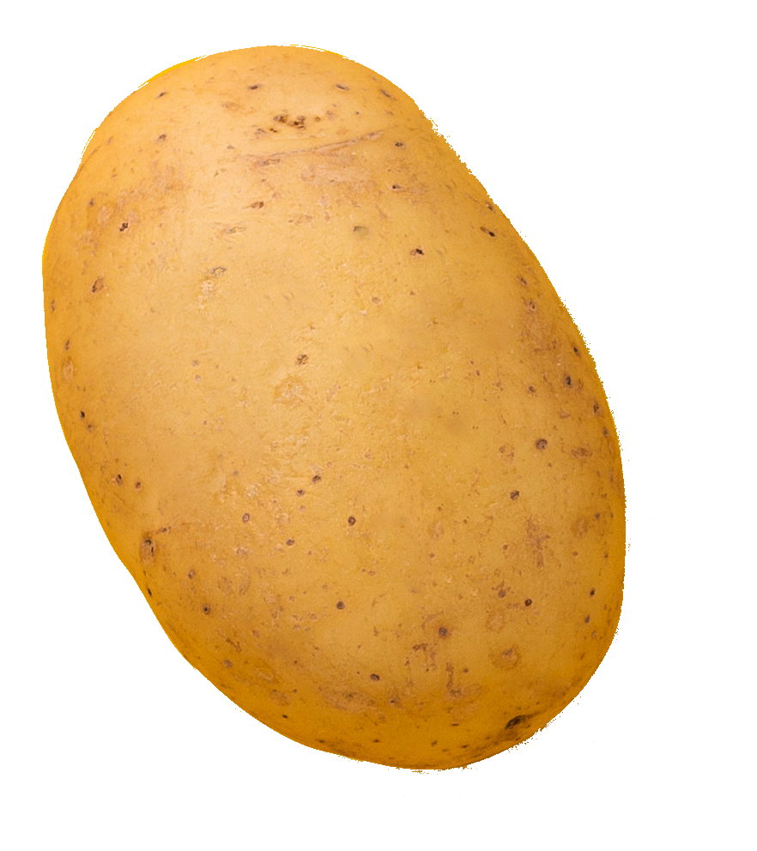

Slide 2
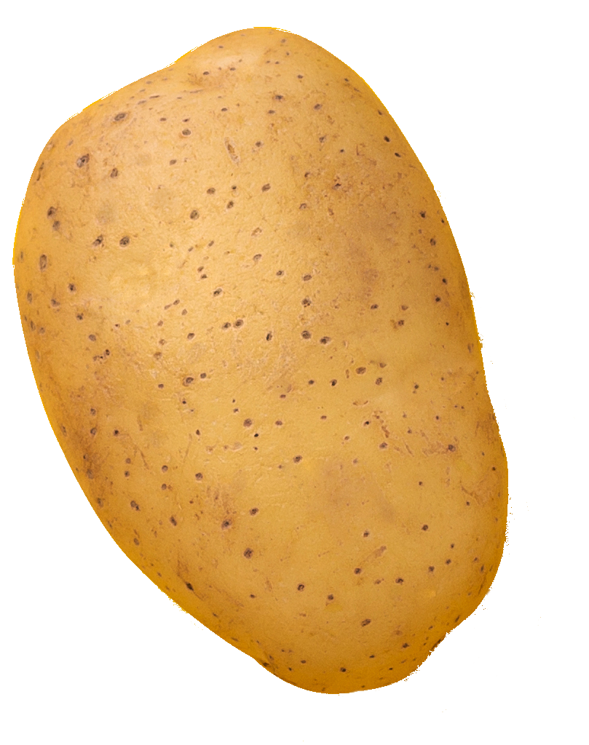

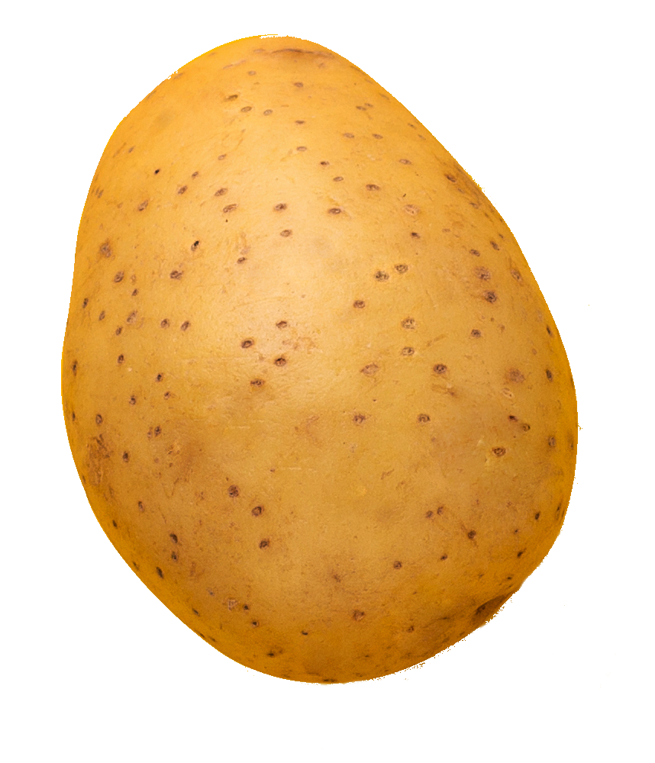
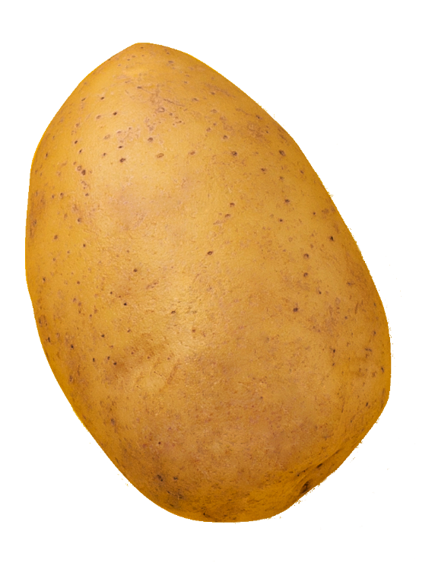
Notes:
30K feet view

Slide 3
Notes:
30K feet view

Slide 4
Notes:
30K feet view

Slide 5





Notes:
30K feet view

Slide 6


Notes:
30K feet view

Slide 7
Notes:
30K feet view

Slide 8


Notes:
30K feet view

Slide 9
Notes:
30K feet view

Slide 10
Notes:
30K feet view

Slide 11
Notes:
30K feet view

Slide 12
Notes:
30K feet view

Slide 13
Notes:
30K feet view

Slide 14

Notes:
30K feet view

Slide 15
Notes:
30K feet view

Slide 16
Notes:
30K feet view

Slide 17
Notes:
30K feet view

Slide 18
Notes:
30K feet view

Slide 19
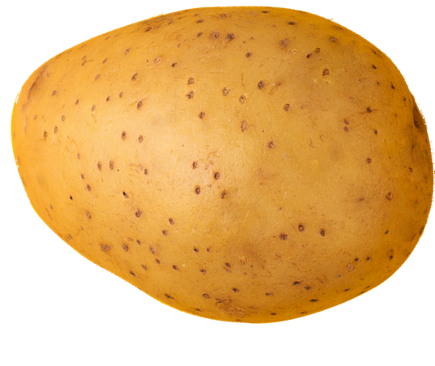
Notes:
Core vs generic domain

Slide 20
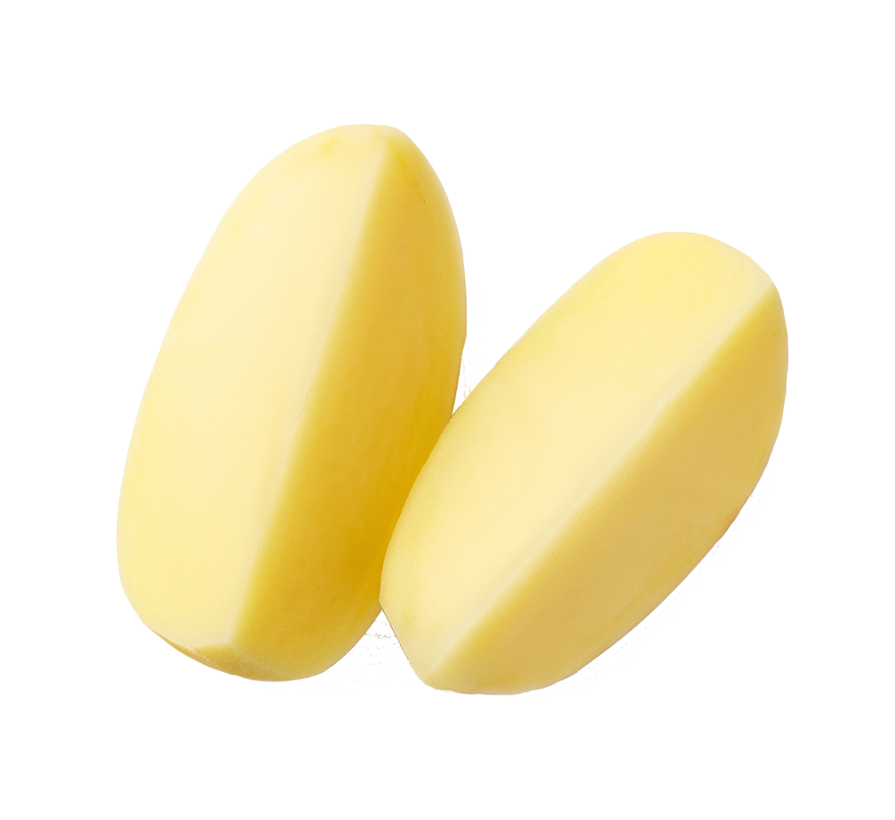
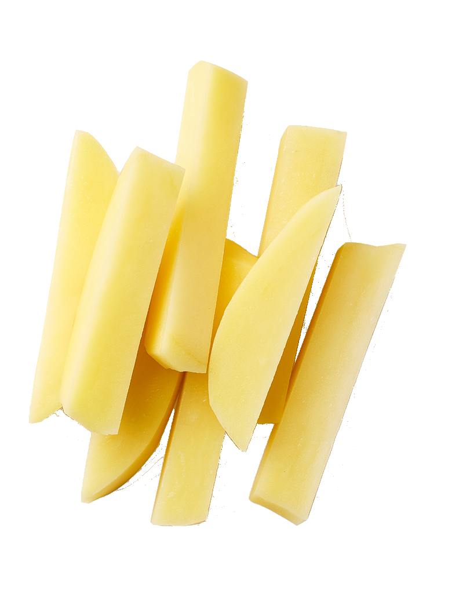
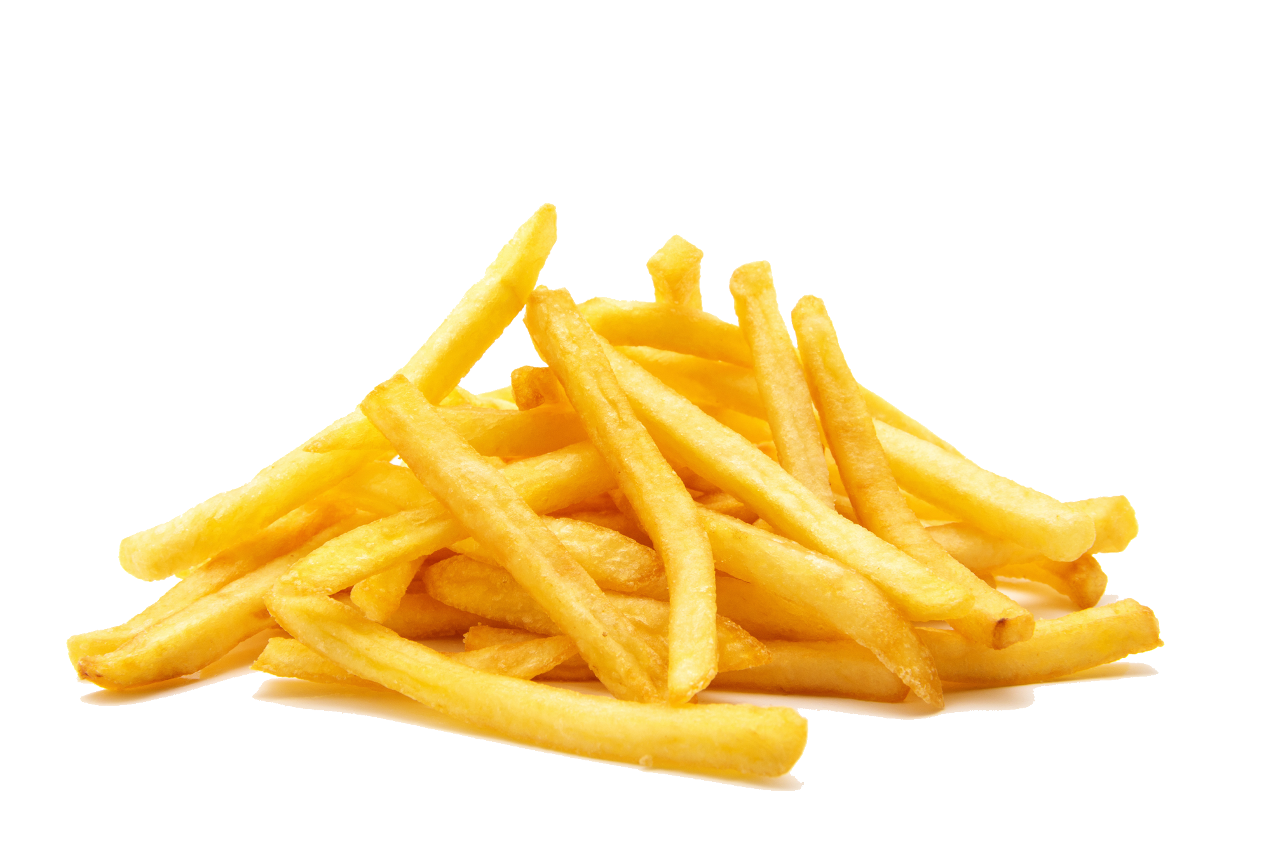
Peel
Cut
Fry

Slide 21


Notes:
Core vs generic domain

Slide 22
Notes:
Core vs generic domain

Slide 23




Notes:
Core vs generic domain

Slide 24

Notes:
How can these communicate?

Slide 25
Notes:
Communication is a separate potato

Slide 26
Notes:
Communication is a core potato

Slide 27

Notes:
Can it be outsourced? Partially

Slide 28
Notes:
30K feet view

Slide 29

Notes:
Potato boundary view
- Message comes in
- Update and send another message

Slide 30
Consume
Save
Notes:
Potato boundary view
- Message comes in
- Update and send another message

Slide 31
Notes:
Update, send another message and mark as processed

Slide 32
Notes:
Update, send another message and mark as processed

Slide 33
Save
Publish
Notes:
Update, send another message and mark as processed

Slide 34
Notes:
Sagas: Update, mark as processed, store messages and later dispatch

Slide 35

Notes:
UT: Http request -> update db and send

Slide 36

Notes:
Previously we had a queue to guarantee re-processing

Slide 37
Notes:
Previously we had a queue to guarantee re-processing

Slide 38
Notes:
Previously we had a queue to guarantee re-processing

Slide 39
Notes:
And now we don’t have the queue in front, so we need to add a queue behind.

Slide 40
Notes:
And now we don’t have the queue in front, so we need to add a queue behind.

Slide 41
Notes:
And now we don’t have the queue in front, so we need to add a queue behind.

Slide 42
Notes:
What if we fail to commit the transaction?

Slide 43
100101001110100011…
Notes:
Aux data store

Slide 45
XYZ
/someFolder/XYZ

Slide 46

http://.../someFolder/4578
XYZ
/someFolder/4578

Slide 47
http://.../someFolder/4580
XYZ
/someFolder/4578
/someFolder/4579
/someFolder/4580

Slide 48
http://.../someFolder/4580
XYZ
4578
4579
4580
/someFolder/4578
/someFolder/4579
/someFolder/4580

Slide 49
http://.../messages/4580
ABC
DEF
4578
4579
4580
/messages/4578
/messages/4579
/messages/4580

Slide 50
http://.../messages/4580
http://.../messages/1234
DEF
GHI
/messages/1234
/messages/4580

Slide 51
http://.../requests/1234
http://.../responses/4580
/requests/1234
/responses/4580

Slide 52
http://.../messages/1234
http://.../requests/4580
/messages/1234
/requests/4580

Slide 53
Claim
Delete

Slide 54
ID=ABC
ID=DEF
http://.../requests/1234
http://.../requests/4580
/requests/1234
/requests/4580

Slide 55
ID=ABC
http://.../messages/4580
/messages/4580

Slide 56
POST
http://.../requests/4580
PUT
/requests/4578
/requests/4579
/requests/4580

Slide 57
POST
http://.../requests/4580
DELETE
/requests/4580

Slide 58
ID=DEF
http://.../requests/4580
PUT
4578
4579
4580
/requests/4578
/requests/4579
/requests/4580

Slide 59
ID=GHI
ID=DEF
http://.../requests/4580
POST
/requests/4580

Slide 60

Message
Load
Document
Update
Message

Slide 61
Message
Request
Load
Document
Update
Message +

Slide 62
Message +
Response
Load
Document
Update
Message

Slide 63
Message +
Response
Request
Load
Document
Update
Message +

Slide 64
Request
Message
Load
Document
Update
Response

Slide 65

Notes:
30K feet view

